Slide 1
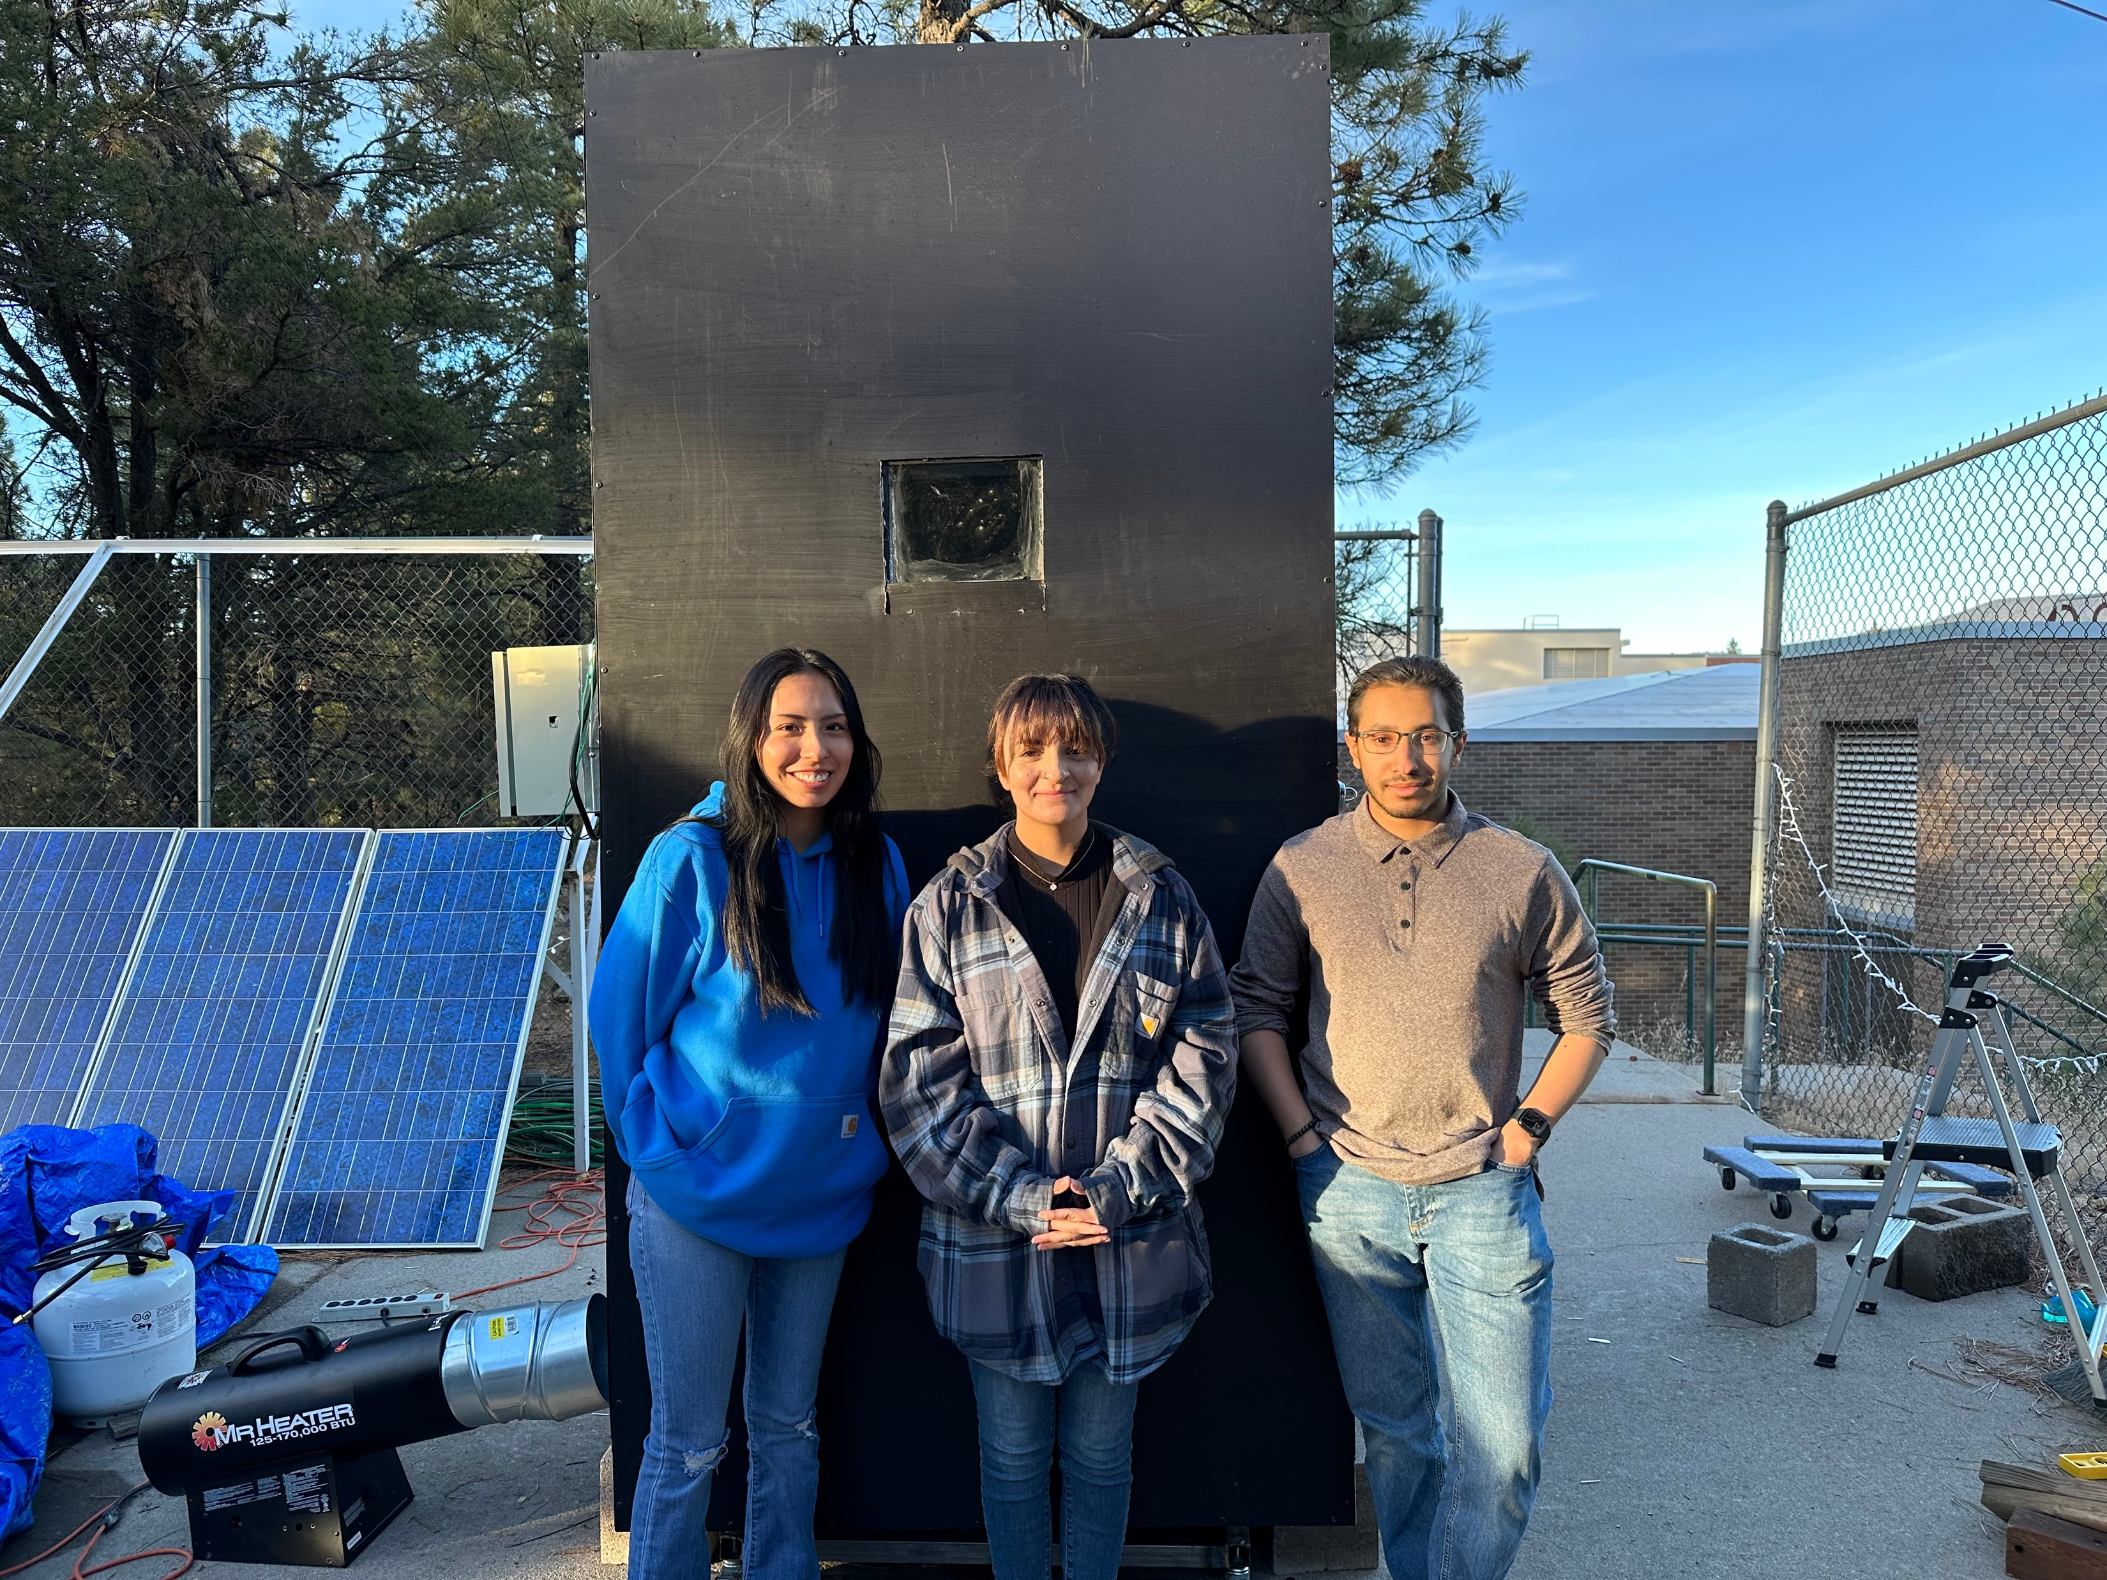
Novel hobby scale powder coating oven with active controls for future student engineering projects
Verina Abdelmesih
Hussain Alismail
Desiree Dee

Slide 2
Project Description
Goal
Design a powder coating oven that can be used by all programs
Work with the bumper capstone team
Powered by a propane fueled torpedo heater
Controlled using a PID control system
Stakeholder
The Renewable Energy Lab
Client
Carson Pete
The powder coating machine will be housed in the renewable energy lab
Hussain 1

Slide 3
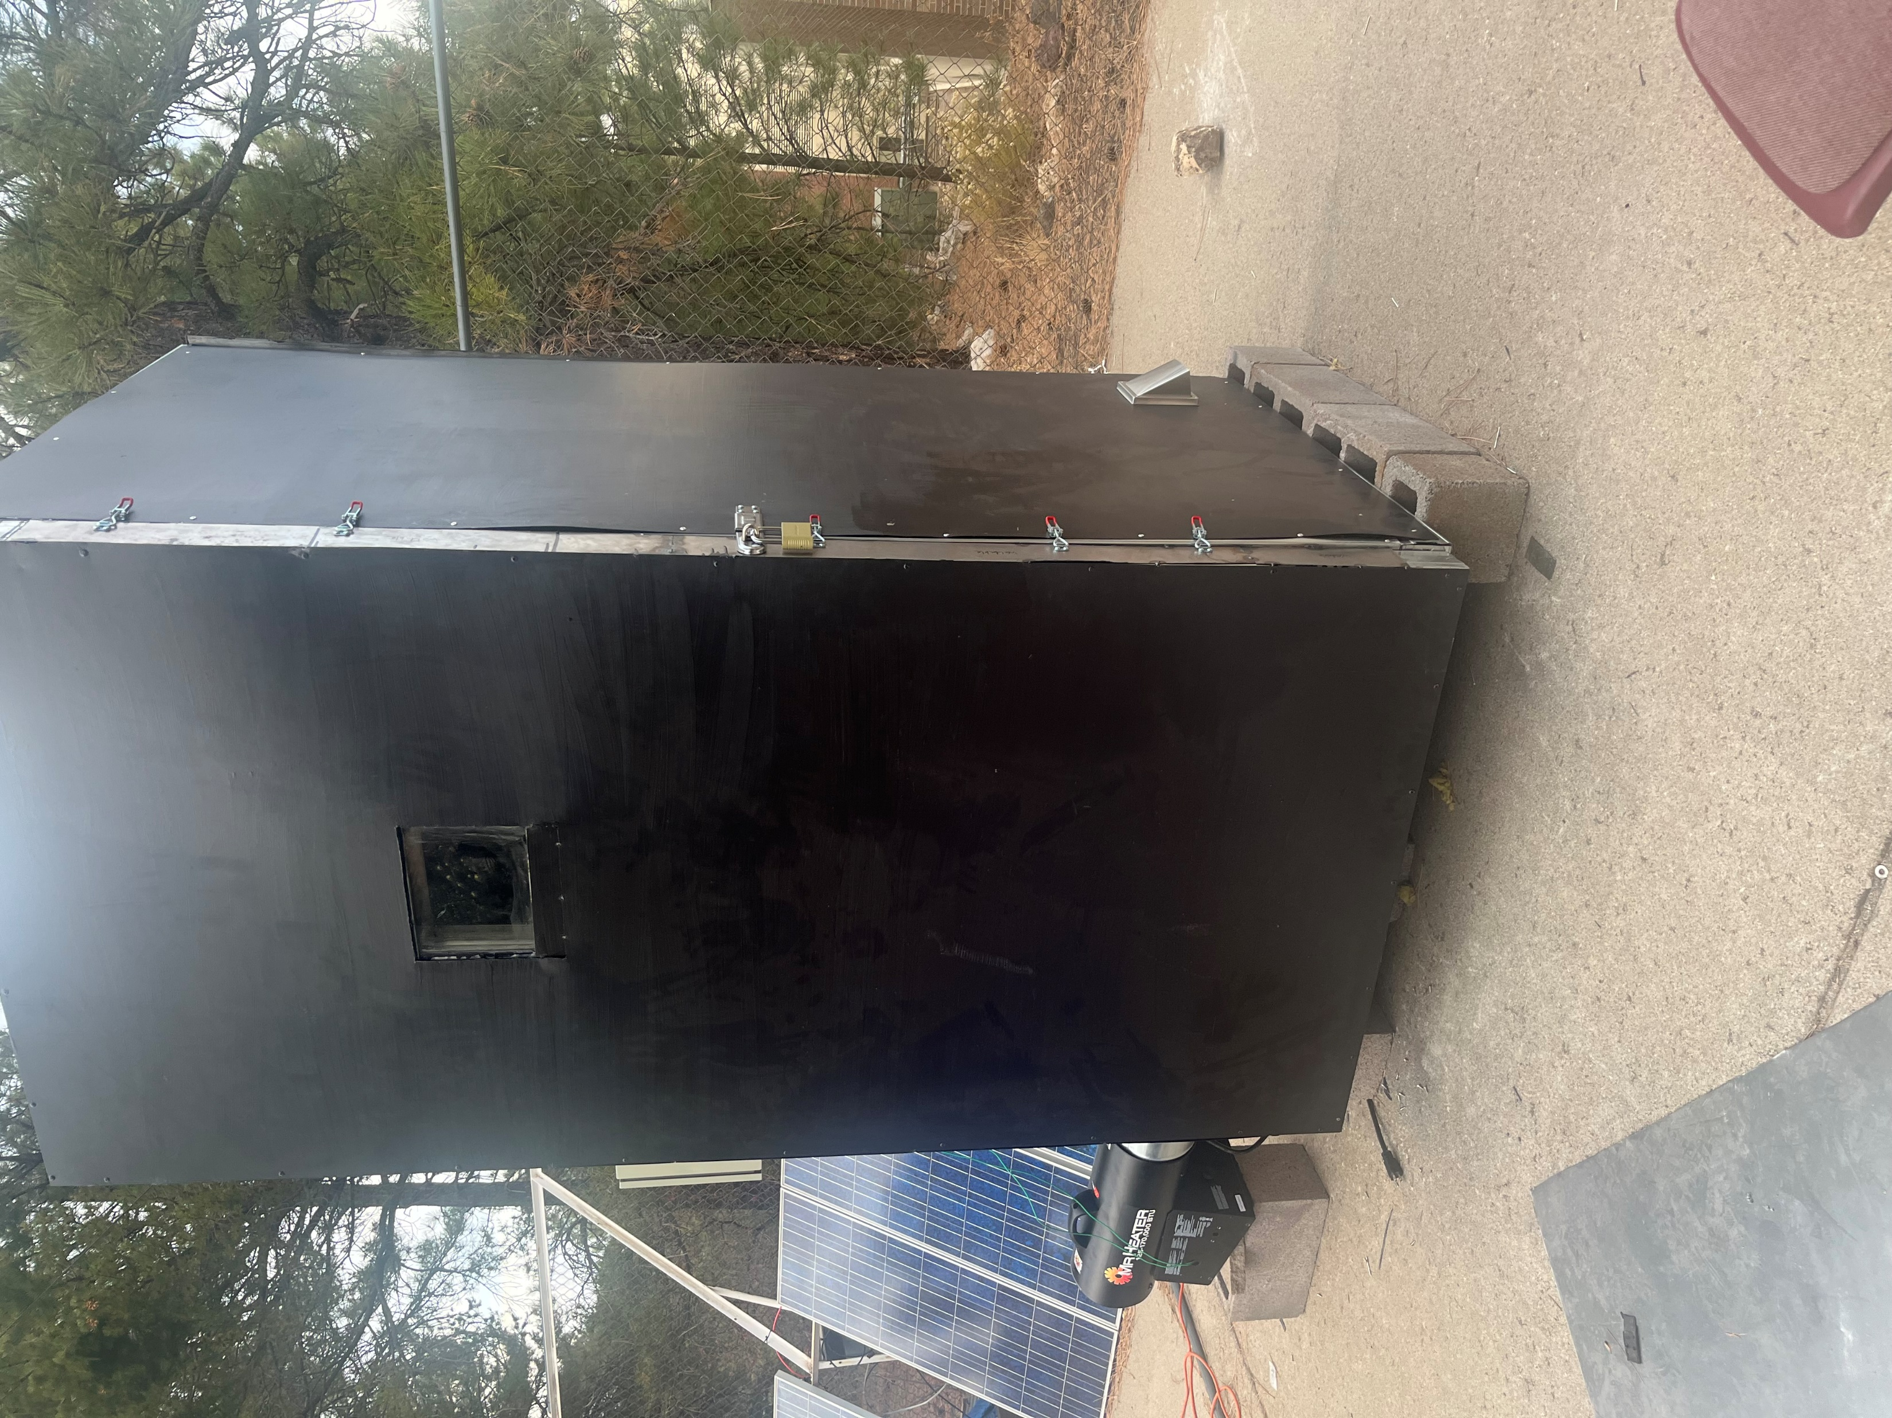
Background
What is Powder-Coating?​
It’s the process of applying fine, pigment particles that are electrically charged and sprayed onto the part.​
What projects can you do with powder coating?​
It could be applied from Simple DIYs to high end industrial applications.​
Powder-Coating ovens?​
The last step for powder coating to cure the powder onto the part.​
Hussain 2

Slide 4
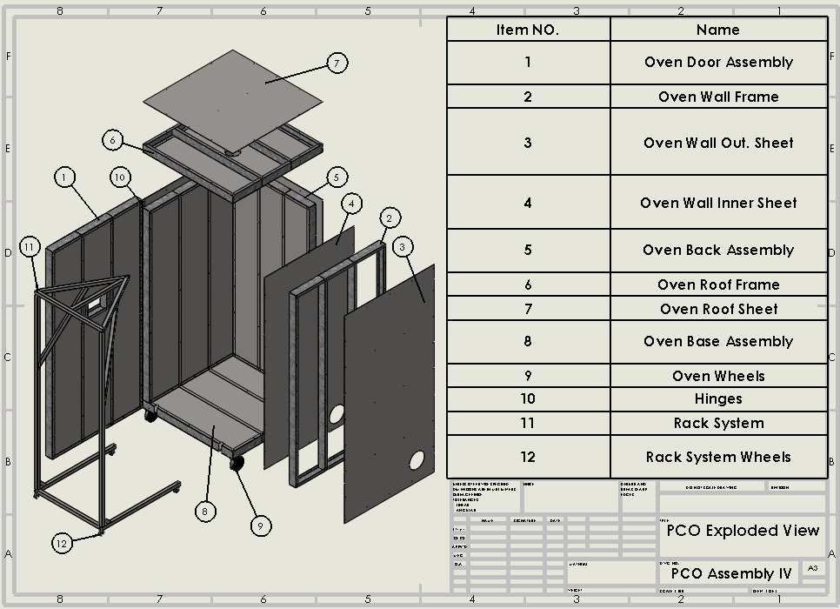
Design Description
Oven Body
Rack System
Torpedo Heater
PID System
Exhaust Vent
Hussain 3

Slide 5

Design Requirements
Engineering Requirements:
ER 1: Rack Holding Weight < 200 pounds
ER 2: Volume (4 x 4 x 8ft)
ER 3: Material Cost < $1,500
ER 4: Heat Loss < 6 W/m^2
ER 5: Heat Output of 400° Fahrenheit
Customer Requirements:
CR 1: Weather Resistant
CR 2: Even Heat Distribution
CR 3: Material Cost < $1,500
CR 4: Volume (4 x 4 x 8ft)
CR 5: Retractable Rack System
CR 6: Propane Fueled Heater
CR 7: Control System for Heater
Hussain 4

Slide 6
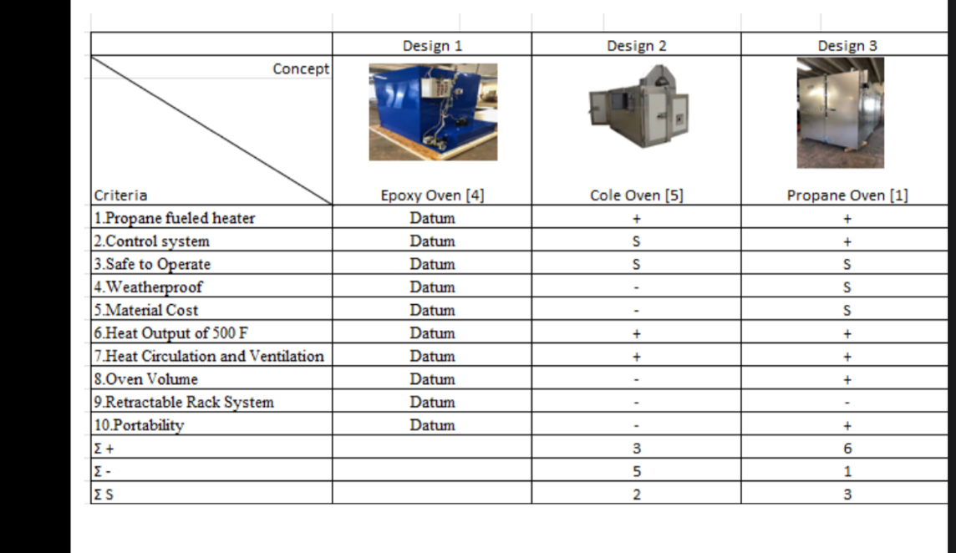
Decision Matrix
Hussain 5

Slide 7
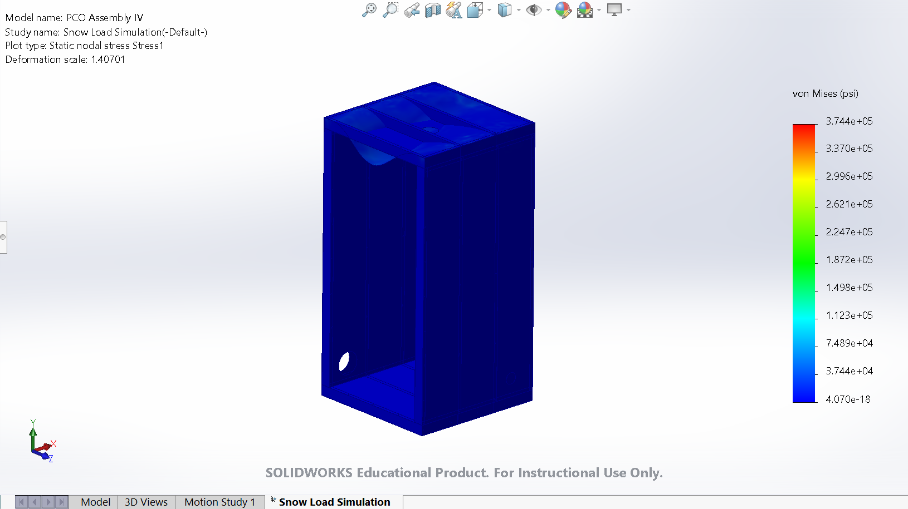

Design Analysis : Structural Analysis
Snow Load Analysis:
$P_{f}=0.7C_{e}C_{t}I_{s}P_{g}$
$P_{f}$ Snow Load = 11.435lbs/${ft}^{2}$ = 183lbs
$C_{e}$ Exposure Factor, 0.8 or 0.9
$C_{t}$ Thermal Factor, 1.1
$I_{s}$ Importance Factor, 1.1
$P_{g}$ Minimum Snow Load, 15lbs/ ${ft}^{2}$
Hussain 6

Slide 8
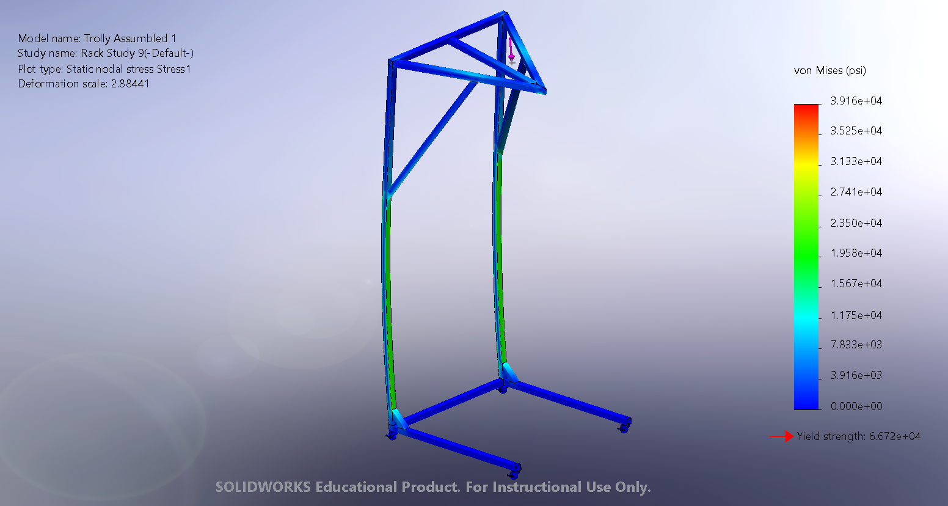

Design Analysis: Structural Analysis
Factor of Safety:
FOS = $\frac{F_{y}}{F_{r}}$
Materials:
1.5” Steel Square Tubes
FOS Required:
1.5
Max Weight Used:
225lbs
Hussain 7

Slide 9
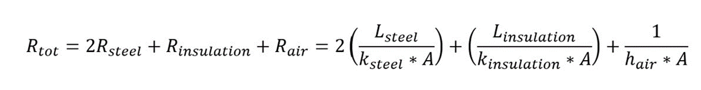
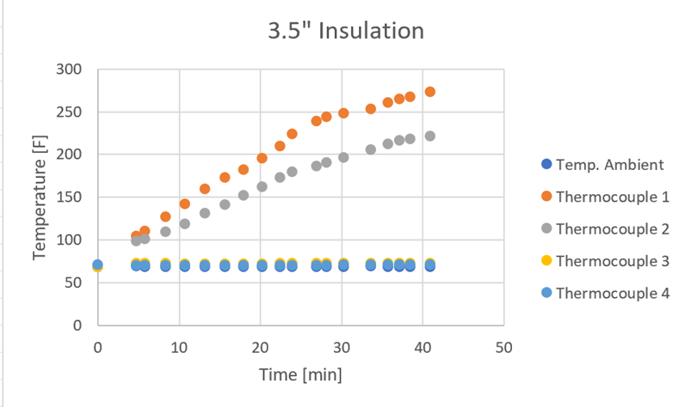
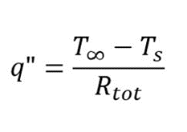
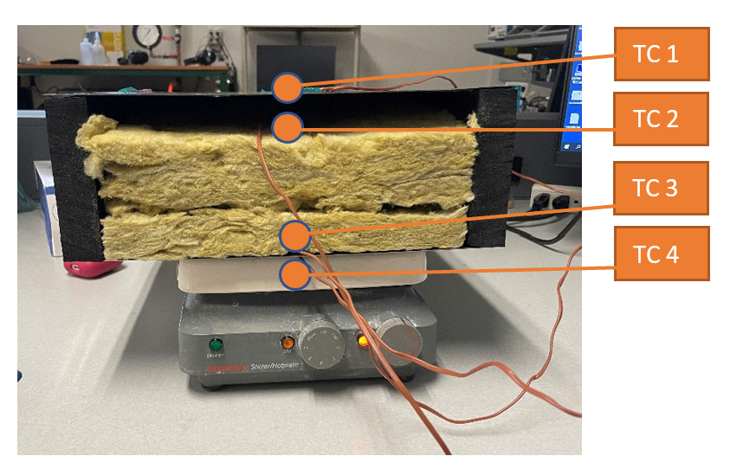
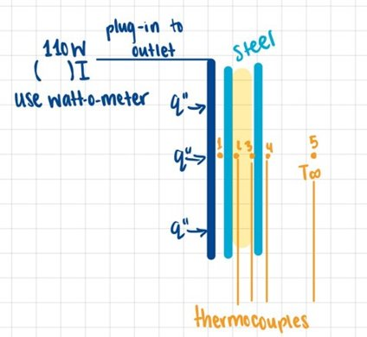
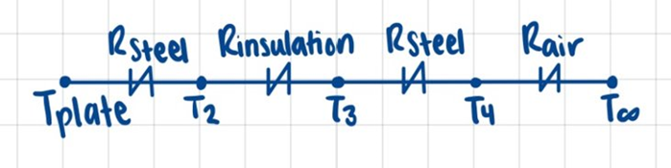
Design Analysis/Prototype 1/Testing plan 2 : Heat Transfer Analysis
Desiree 8

Slide 10
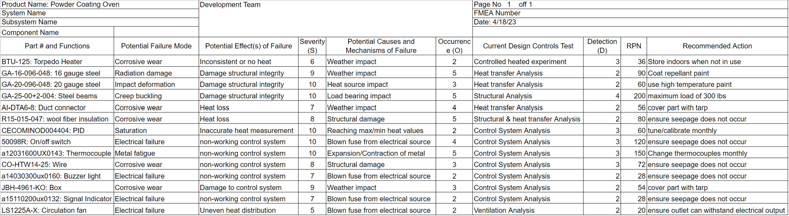
Design Validation: FMEA
Desiree 9

Slide 11
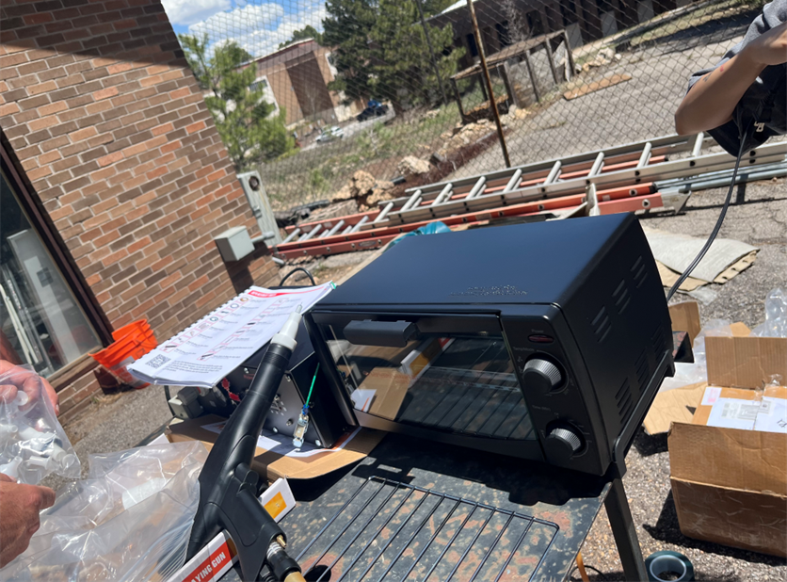
Prototype 2: Powder Coating Technique
Prep/Pretreatment
Use Super Degreaser to clean the part
Blast/Sand down the object to remove impurities
Use AllPrep Iron Phosphate
Use an Epoxy base coat and cure for longer
than powder curing time
Application
Ground part using a wire
Note Faraday areas
Preheat part with oven to improve adhesion

Slide 12
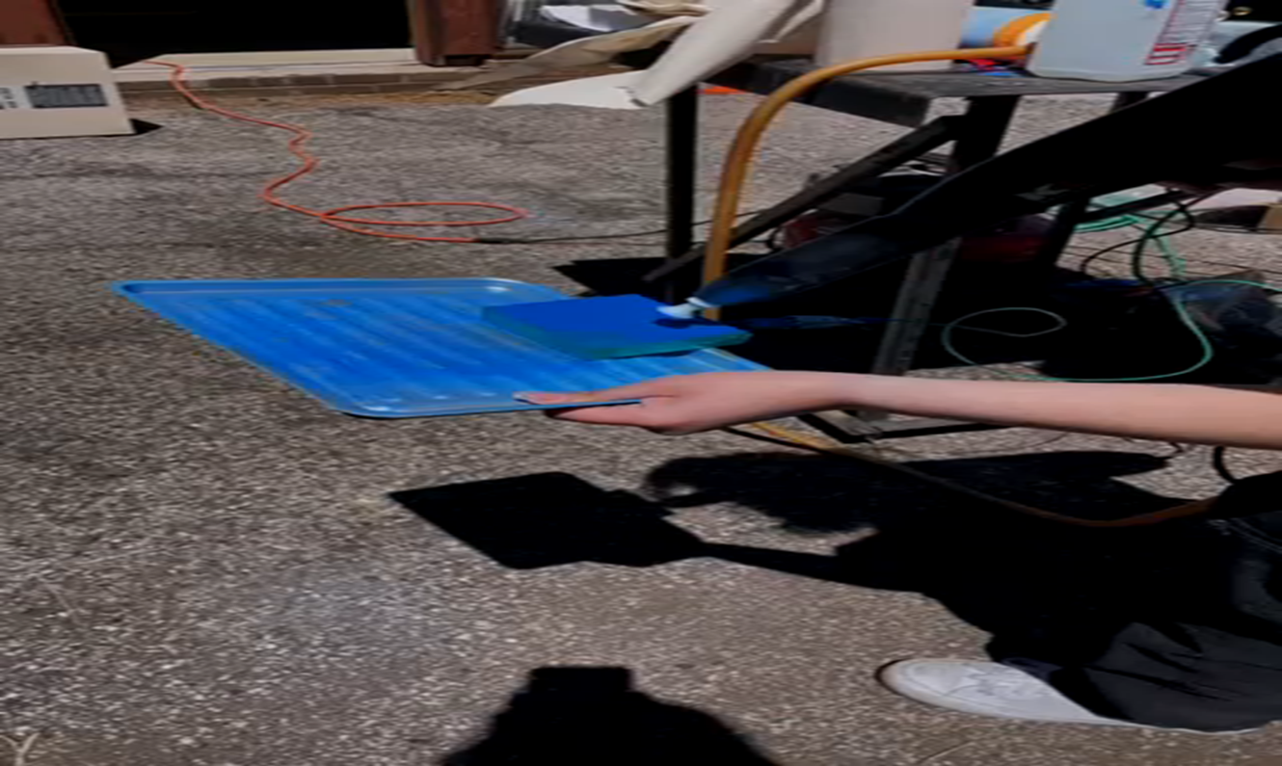
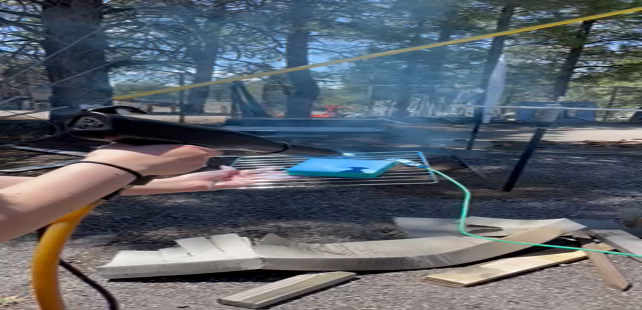
Desiree 11

Slide 13
Manufacturing Plan
Calculate and measure the distance of the rivet on the oven frame.
Cut out holes in the door sheet panels for the tempered glass.
Rivet interior sheet metal to each framing
Rivet the framing of the oven together excluding the door.
Create the frame of the door. Include a frame for the tempered glass so that it doesn’t contact insulation.
Assemble oven frame with sheet metal
Measure the holes in the cold-rolled steel panels for the heater, vent, and blower.
Desiree 12

Slide 14
Manufacturing Plan Pt. 2
9. Cut the top inside panel of the oven wall for the light placement. Then make the holes for the burner and the vent.
10. Add the insulation. Then add the wiring for the thermocouple and light bulb along with the light bulb mount to the oven
11. Then attach the outer panels of the oven and paint with high temperature Rust-oleum.
12. Cut the holes of the vent and heater on the outer panels of the oven
13. Attach the door to the oven using piano hinges and latches
14. Attach the control system, vent, and heater to the oven
Desiree 13

Slide 15
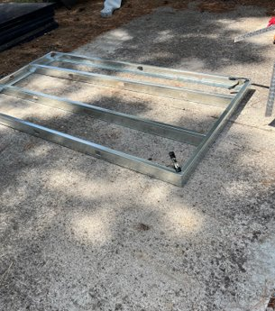
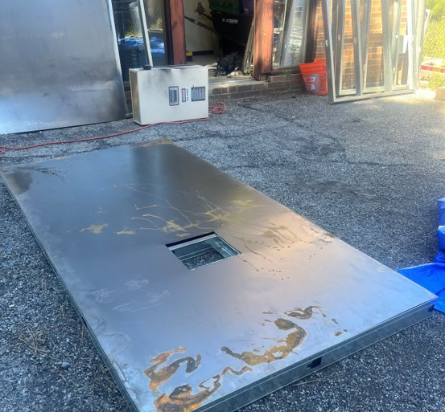
Manufacturing Process
Desiree 14

Slide 16
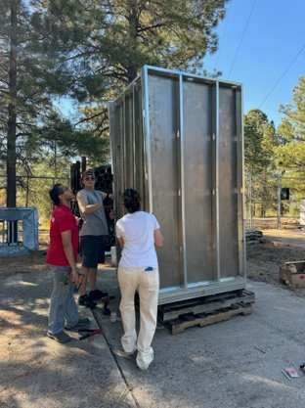
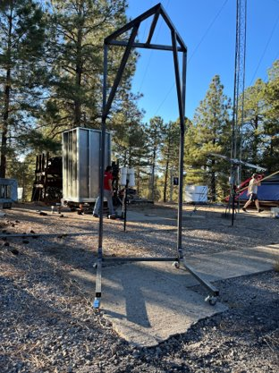
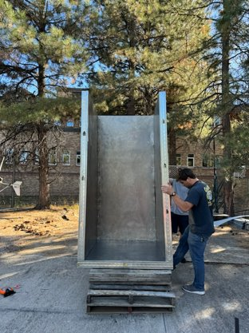
Desiree 15

Slide 17
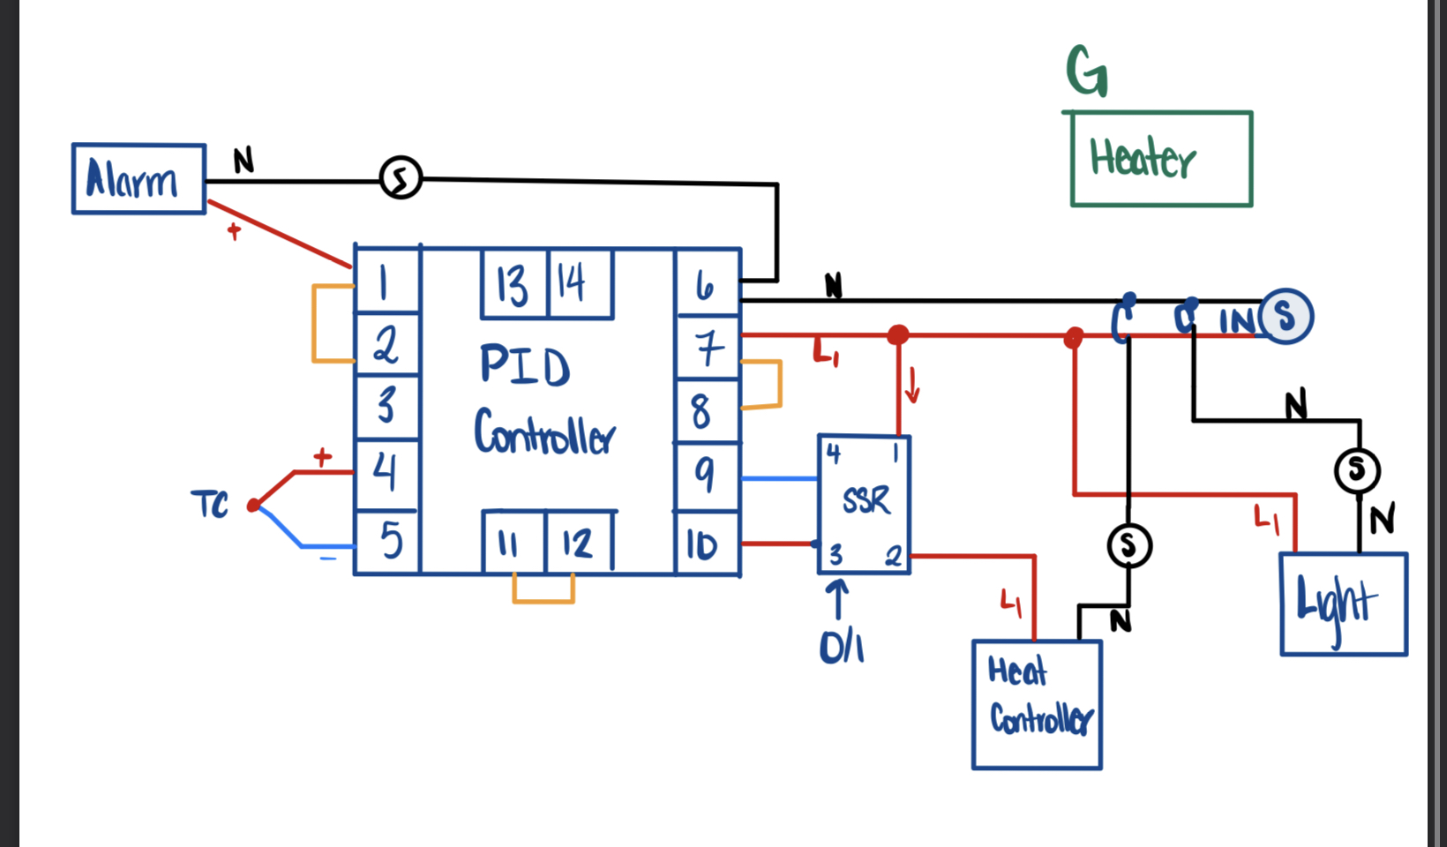
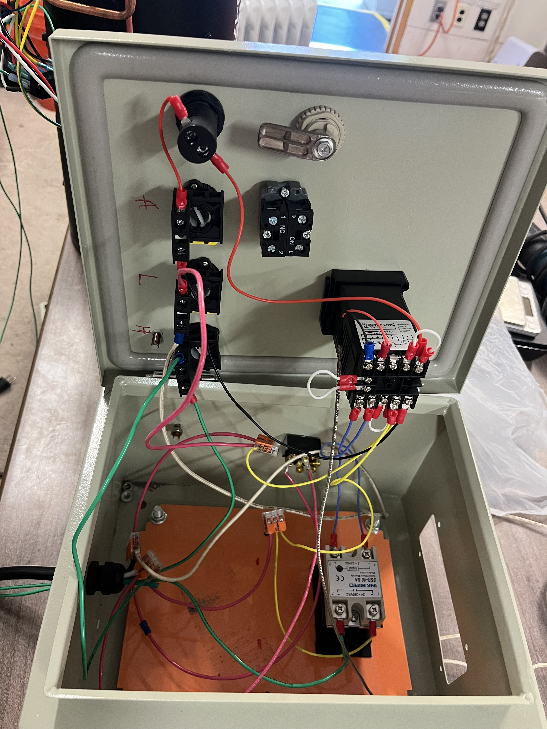
Wire Color Key
Alarm : Red
Alarm Switch : Black
Light : Pink and Cream
Heater : Green
Terminal to Terminal : White
Terminal to SSR : Blue
Anything to Connector : Yellow
Verina 16

Slide 18
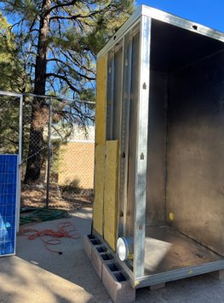
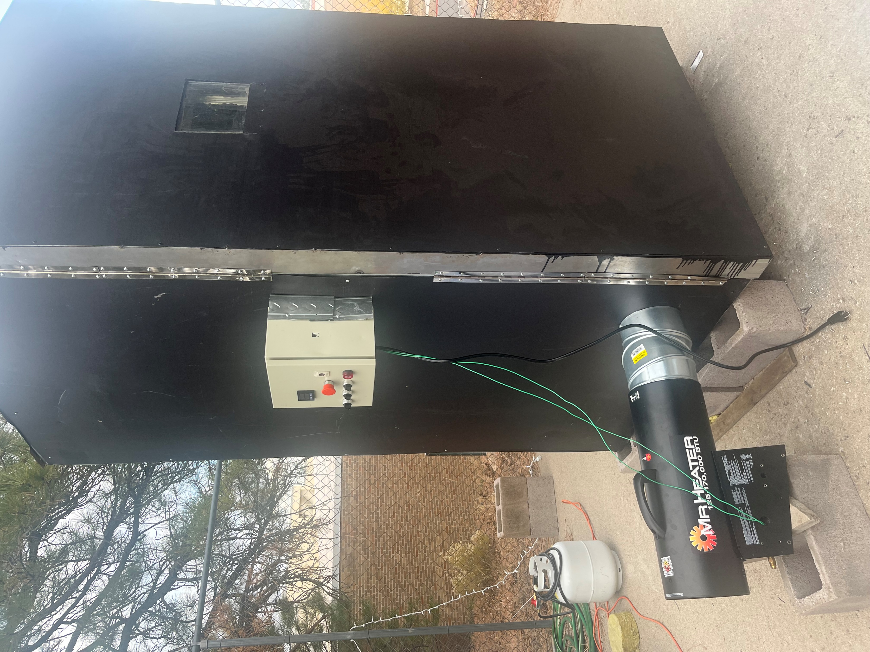
Verina 17

Slide 19
Test 3: control system
Design requirements​
ER5: Heat output of 400 degrees ​
CR2: Even Heat Distribution​
CR6: Propane Fueled Heater​
CR7: Control System for Heater
Verina 18

Slide 20
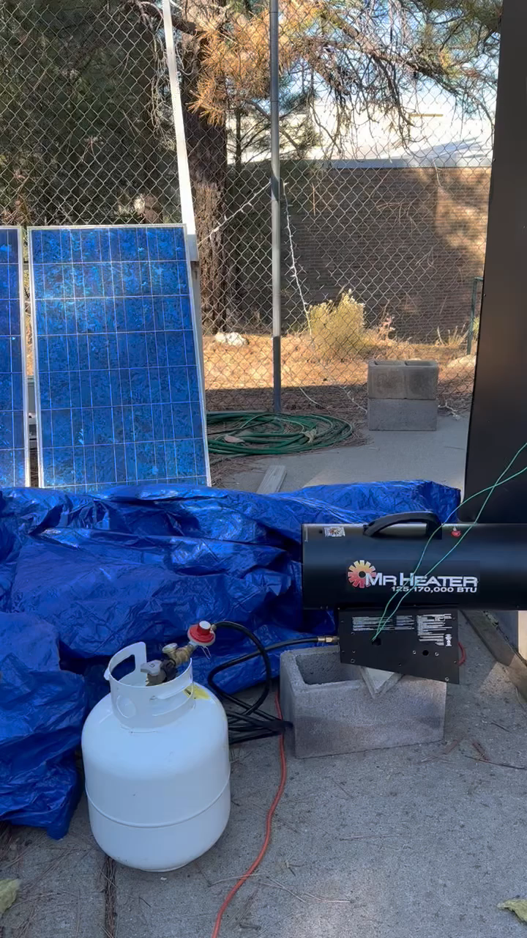
Verina 19

Slide 21
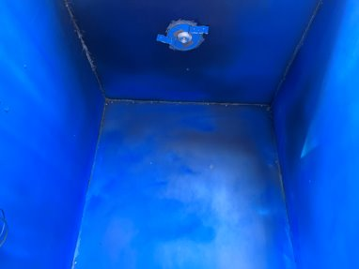

Test 4: Heat Ventilation and circulation
Design requirements:​
ER5: Heat output of 400 degrees F ​
CR2: Even Heat Distribution​
CR6: Propane Fueled Heater​
CR7: Control System for Heater​
One Coat
Two Coats​
Verina 20

Slide 22
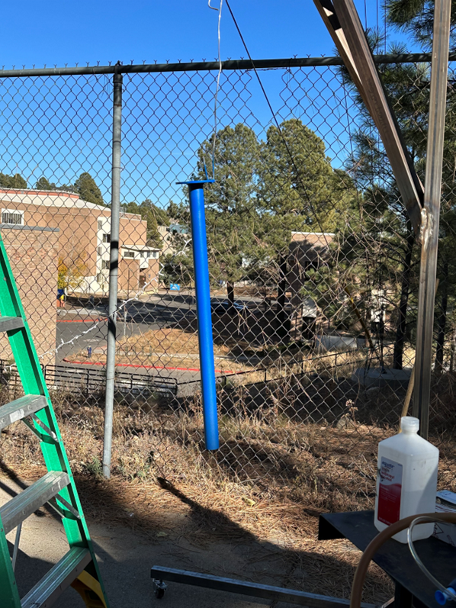
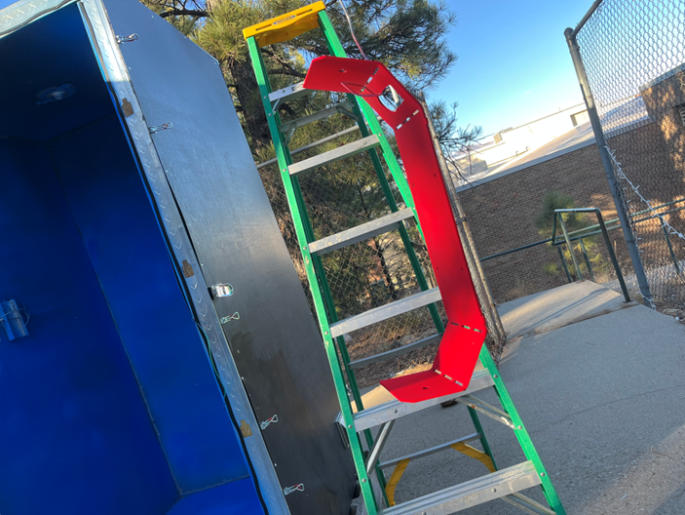
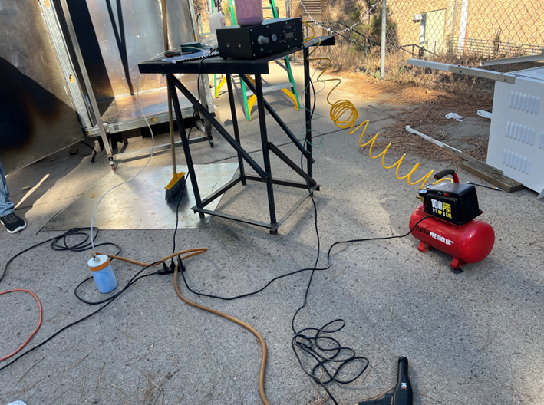
Test 5 : Curing techniques on rack
Design requirement
CR2: even heat distribution
CR5: retractable rack system
Verina 21

Slide 23
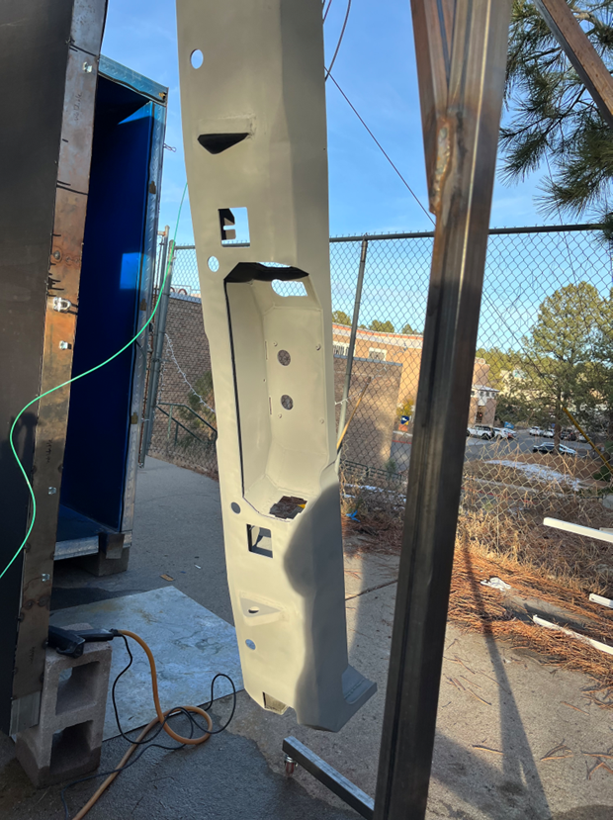
Test 6: Rack System weight test
Design requirements
ER1: Rack holding weight < 200 lbs
CR5: Retractable rack system
Verina 22

Slide 24
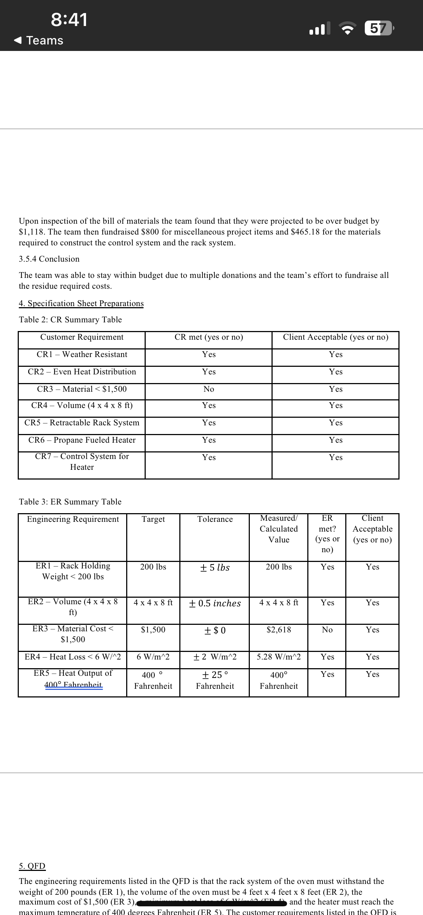
SPECIFICATIONS SHEET: CUSTOMER REQUIREMENTS​
Verina 23

Slide 25
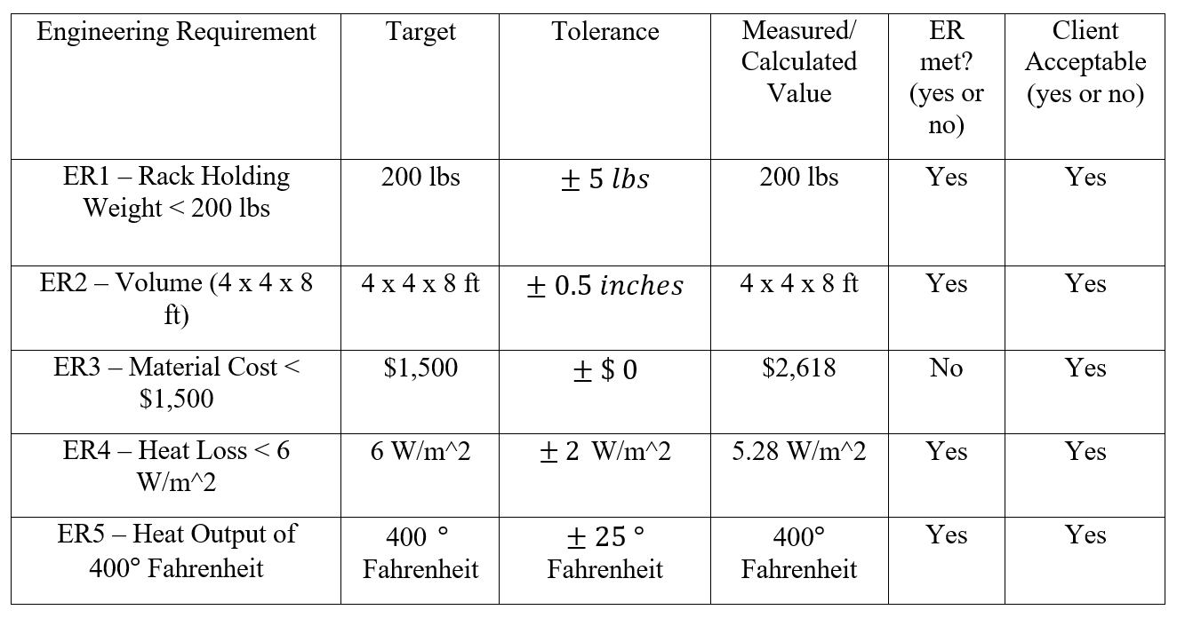
SPECIFICATIONS SHEET: ENGINEERING REQUIREMENTS

Slide 26
Future Work
Improve vent system
Sync vent to PID so that it open and closes when the oven reaches certain temperatures instead of heater turning on and off
Will allow for oven to be more fuel efficient
Verina 24

Slide 27

Questions?
Please feel free to visit our website!

Slide 28
References
[1] Basic instructions, https://www.columbiacoatings.com/resources/basic-instructions (accessed Nov. 2, 2023). ​
[2] “How to build a PID controlled toaster oven | full guide | round 2,” YouTube, https://www.youtube.com/watch?v=PuoiD9mwmUQ​
(accessed Nov. 2, 2023). ​
[3] S. Castle, “How to build a powder coating oven,” Powder Coating: The Complete Guide, https://www.powdercoatguide.com/2014/09/how-to-build-powder-coating-oven.html (accessed Nov. 2, 2023). ​
[4]S. Castle, “How to build a powder coating oven part ii,” Powder Coating: The Complete Guide, https://www.powdercoatguide.com/2014/09/how-to-build-powder-coating-oven-part-ii.html#.WLn0GH-mLWB (accessed Nov. 2, 2023). ​
[5] Name, B. M. says:, S. says:, A. V. says:, and G. W. I. says:, “Engineer Essentials LLC - creators of GD&T Basics,” GDT Basics, https://www.gdandtbasics.com/asme-y14-5-gdt-standard/ (accessed Nov. 2, 2023).​
[6] “Factors of safety - fos,” Engineering ToolBox, https://www.engineeringtoolbox.com/factors-safety-fos-d_1624.html (accessed Nov. 2, 2023).​

Slide 29
[7] Northern Arizona University, "ME 495 – Intro to Data Acquisition with NI & Arduino," Flagstaff, AZ, 2022 ​
[8] “Mineral Wool Insulation,” Engineering ToolBox. [Online]. Available: https://www.engineeringtoolbox.com/mineral-wool-insulation-k-values-d_815.html. [Accessed: 30-Apr-2023]. ​
[9] Dan, “Calculating the developed length of a rolled cylinder,” The Chicago Curve, 22-May-2016. [Online]. Available: https://www.cmrp.com/blog/plate-rolling/calculating-the-developed-length-of-a-rolled-cylinder.html#:~:text=The%20AutoCAD%20default%20K%20value,your%20software%20to%20K%20%3D%200.50. [Accessed: 30-Apr-2023]. ​
[10] “Convection heat transfer coefficient,” Convection Heat Transfer Coefficient - an overview | ScienceDirect Topics. [Online]. Available: https://www.sciencedirect.com/topics/engineering/convection-heat-transfer-coefficient. [Accessed: 30-Apr-2023]. ​
[11] “Calculating roof snow loads w/ ASCE 7-10: Skyciv,” SkyCiv Cloud Structural Analysis Software | Cloud Structural Analysis Software and Calculators, https://skyciv.com/docs/tech-notes/loading/calculating-roof-snow-loads-w-asce-7-10/ (accessed Nov. 16, 2023)

